Slide 1
Blink Rendering
Rebuilding the Engine Mid-Flight

Slide 2
What is rendering?
Turning DOM into pixels, 60 times per second.
blink/renderer/core/layout blink/renderer/core/paint blink/renderer/core/style
blink/renderer/platform/graphics blink/renderer/platform/text blink/renderer/core/frame blink/renderer/core/page ...
Notes:
Historical note about team organization.

Slide 3
How Rendering Happens
network
script
parse
style
layout
compositing
setup
paint
raster
composite
input
Notes:
Here are the main phases of the document lifecycle.
The four darker boxes in the middle are the rendering pipeline.

Slide 4
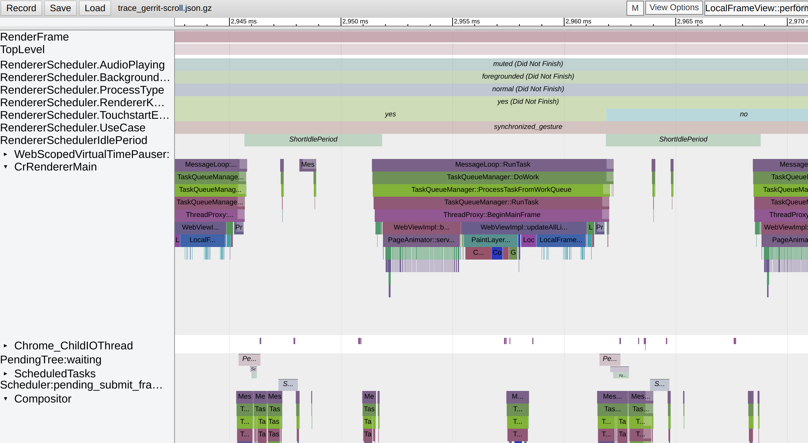
network
script
parse
style
layout
compositing
setup
paint
raster
composite
input

Slide 5
network
script
parse
style
layout
compositing
setup
paint
raster
composite
input
Notes:
The highlighted area of the trace is renderer’s main thread.
We’re just strolling along, running javascript, handling resource loads.

Slide 6
vsync!
network
script
parse
style
layout
compositing
setup
paint
raster
composite
input
Notes:
vsync means the browser has pushed a frame of video output to the display.
Now, it’s time to get the next frame ready.

Slide 7
network
script
parse
style
layout
compositing
setup
paint
raster
composite
input
Notes:
vsync triggers BeginMainFrame, which is where all the excitement happens.

Slide 8
network
script
parse
style
layout
compositing
setup
paint
raster
composite
input
Notes:
First, we handle input events (scroll, touch, gesture, mouse, etc.).
Then, run requestAnimationFrame callbacks.

Slide 9
network
script
parse
style
layout
compositing
setup
paint
raster
composite
input
Notes:
Now the rendering pipeline goes to work.
Update the layout tree and apply styles.
Run layout to size and position objects.
Determine the configuration of composited layers.
Create a “display list” of primitive drawing commands.

Slide 10
network
script
parse
style
layout
compositing
setup
paint
raster
composite
input
Notes:
Now the main thread hands off to the compositor thread.
The rasterization work is split into “tiles” and dispatched to several worker threads.
When rasterization is complete, everything is sent to the chrome compositor.

Slide 11
network
script
parse
style
layout
compositing
setup
paint
raster
composite
input
Notes:
... and then the whole process starts over again.

Slide 12
Rendering is Important, Rendering is Hard
Rendered output is the foremost component of user experience.
Excluding javascript, rendering is the biggest determinant of performance.
Modern web pages feature lots of dynamic content.
Notes:
The nature of a dynamic web page is taking inputs -- generated by the user, or by script -- and turning it into visual results. Rendering is at the heart of this process.
Aside from pathologically long-running javascript, this is the main determinant of web page performance (both perceived and actual).
Modern web pages are dynamic -- constantly modifying content. To keep pace, and keep the display smooth, the rendering code has to be tip-top.

Slide 13
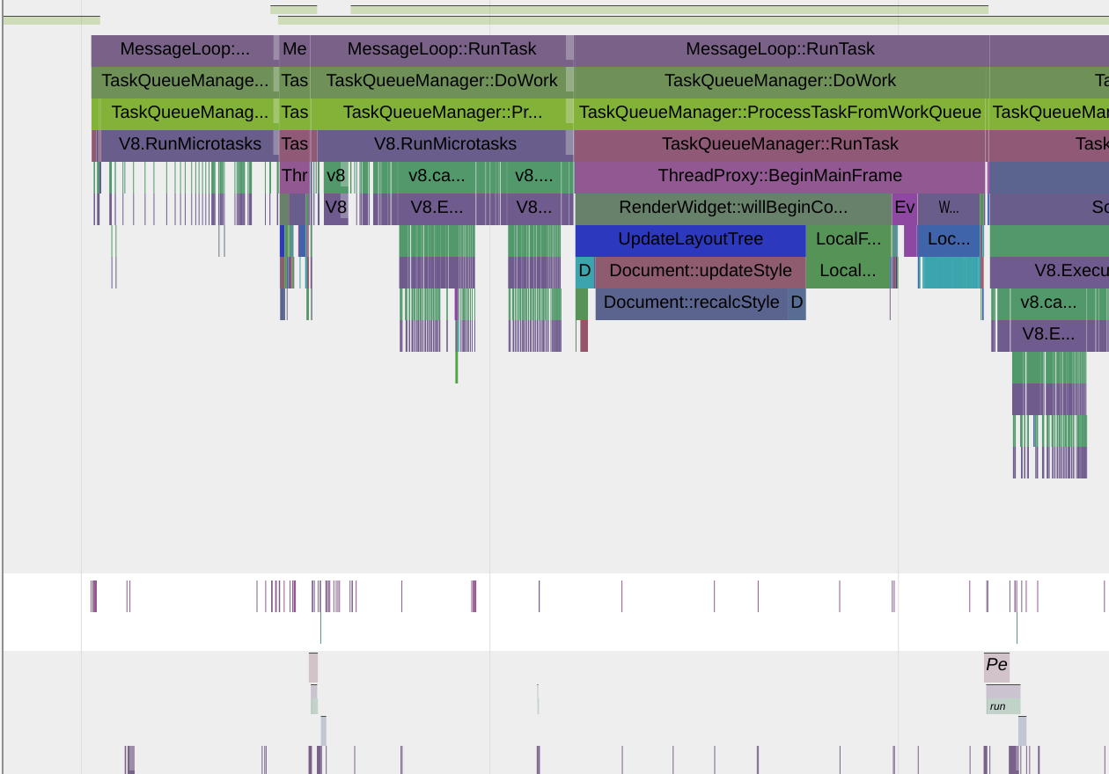
network
script
parse
style
layout
compositing
setup
paint
raster
composite
input
Notes:
TODO: show vsync, missed frame deadline

Slide 14
network
script
parse
style
layout
compositing
setup
paint
raster
composite
input

Slide 15
Rendering challenges
Scrolling
Paint & Compositing
Layout
Notes:
[Stefan rant] Perception of scrolling performance is the biggest factor in perception of overall performance. It doesn’t matter how awesome your page is if the scrolling is janky.
Scrolling code is super hairy and subtly woven into many parts of blink and chrome. It spans the main and compositor threads in the renderer, and even involves the browser process.

Slide 16
Scrolling: A Brief History
Notes:
Document scrolling in the initial version of KHTML (1998).
Div scrolling added to WebKit in 2003.
Needed to re-run rendering pipeline on every change.

Slide 17
Scrolling: Features, Optimizations, Complexity
Composited Scrolling
Threaded Scrolling
Custom Scrollbars
Scroll Event Handling
Touch/Fling Scrolling
Pinch Zoom
...
Notes:
Over the years, scrolling accrued lots of optimizations and features.
Also...
Scroll Animations
Scroll Anchoring
Sticky Position

Slide 18
Root Layer Scrolling: One is Better than Two
Initiated by Steve Kobes in 2014
Goal: make document-level scrolls use the overflow scrolling code path
Motivation: code health ... but also resulted in many extra benefits
Shipped in M66
Notes:
LocalFrameView delegates to PaintLayerScrollableArea attached to LayoutView for document-level scrolls.
4 year project, on-and-off, with 5 engineers towards the end.
Challenges to land:
Show one perf improvement that was compelling.
Maybe show a histogram graph and pick a fall and describe what had to be done to fix it.
It’s a spacex landing, absolutely everything needs to be right.
Results:
We fixed lots of bugs along the way
We will get to delete lots and lots of code
The end state is much more tractable
Previously, anything that touched scrolling had to be implemented twice
Unblocks slimming paint

Slide 19
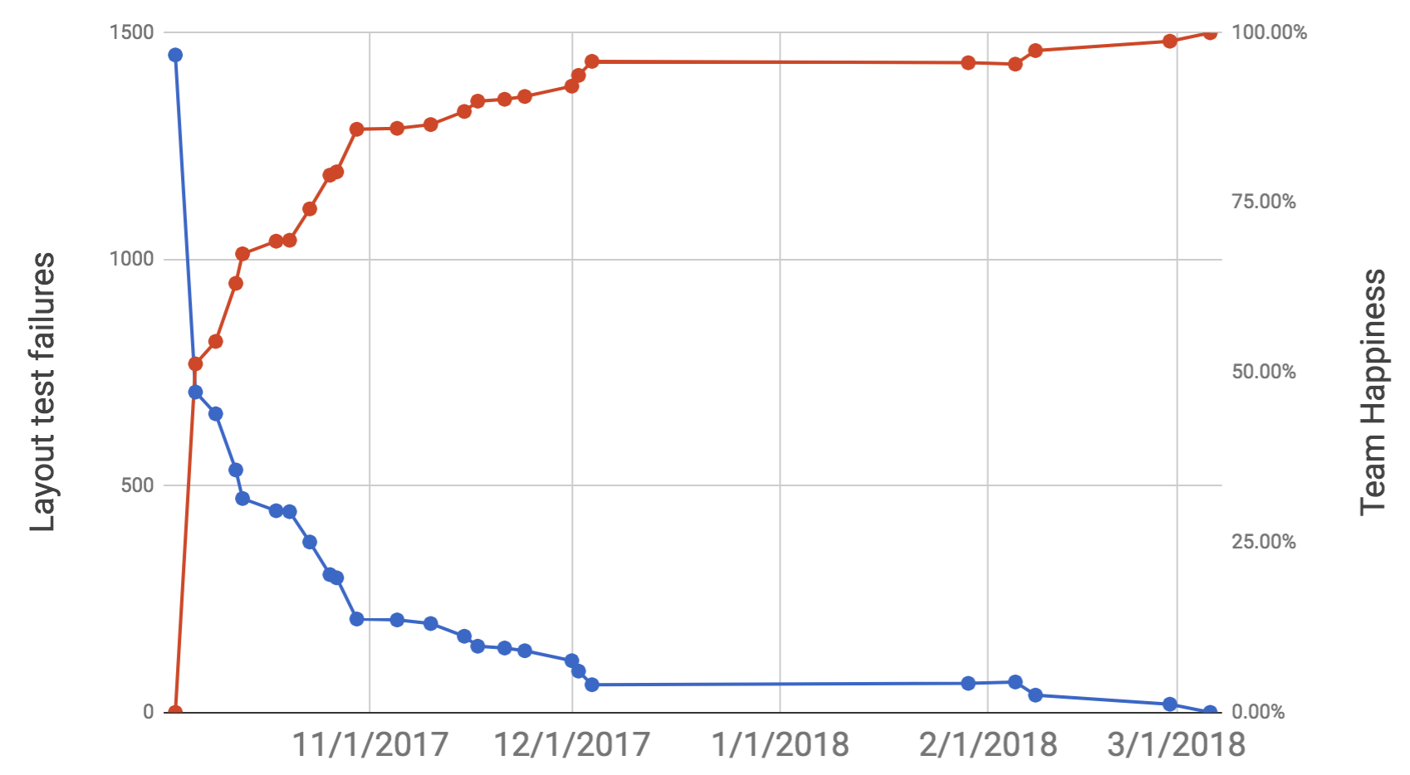
Root layer scrolling
Layout Test Failures
Team Happiness
Notes:
Want to show: correctness was hard-won

Slide 20
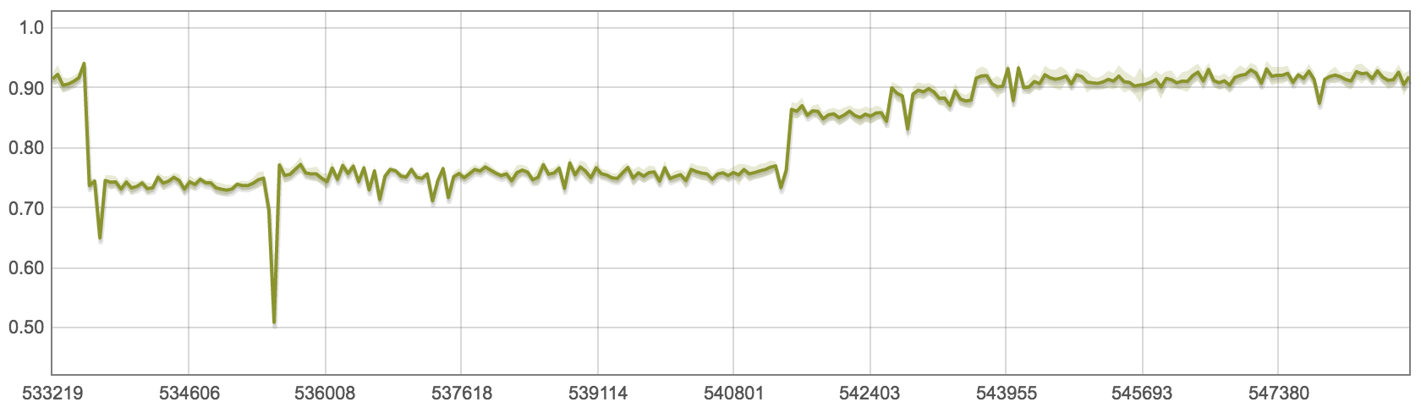
Root layer scrolling
Optimize hit test data structure
RLS enabled as experimental
Optimize hit test
algorithm
Improve inlining
Fix hit test coordinates
Notes:
Want to show: performance was hard-won

Slide 21
Root layer scrolling
Steve Kobes (skobes@)
Stefan Zager (szager@)
Philip Rogers (pdr@)
David Bokan (bokan@)
Vladimir Levin (vmpstr@)
Chris Harrelson (chrishtr@)

Slide 22
Rendering challenges
Scrolling
Paint and Compositing
Layout
Notes:
Like scrolling, the paint and compositing code has grown over time.
Opportunities in this code to improve performance, reduce memory, and make it easier to implement new features.
Umbrella project: slimming paint
Goal: describe the slimming paint design, why it's great, and where we are at.
Useful to start with scrolling in the current architecture

Slide 23
History: naïve scrolling
Email 1
Email 2
Email 3
Email 4
Email 5
Email 6
Email 7
Email 8
Email 1
Email 2
Email 3
Email 4
Email 5
Email 6
Email 7
Email 8
Notes:
When overflow scrolling was first added, needed to re-run rendering pipeline (talked about earlier) on every change
Main thread: if this is gmail, and background task runs, scroll janks

Slide 24
History: composited, threaded scrolling
Composited: Scrolling becomes a blit*
Threaded: Don't have to wait for main thread
Amazing
Email 1
Email 2
Email 3
Email 4
Email 5
Email 6
Email 7
Email 8
Notes:
How does it work? Will it blend?
Threaded: handle scrolling off main thread
E.g., gmail can archive email without making scroll jump
Important because main thread is precious and busy.
Composited layers
Instead of drawing just the scroll area that's visible, draw entire area into a texture
Together, scrolling becomes just moving a texture.
This is fast using software rendering; with a gpu it is criminally fast.

Slide 25
History: composited, threaded rendering
Works for more than scrolling
Opacity, transforms, animations, etc.
Spectacular
Composited
transforms
Composited
transforms
Composited
transforms
Notes:
This idea was generalized to any visual update that can be represented as a texture manipulation (i.e., without going through the long and slow rendering machinery from the previous slide)
Even pre-GPU, this was much faster. With GPU’s, it’s criminally fast.
Only 57% of pageviews use GPU compositing

Slide 26
History: composited, threaded rendering
But...
Makes everything crazy!
Composited
transforms
Composited
transforms
Composited
transforms
Notes:
Example:
Pages had layer explosion: used too much memory
If middle green box can spin, the compositor can move it anywhere, need to ensure things that can overlap are also composited.
Median layer count is around 20 per page.
Real problem: Full-page layer on 5k imac is 60MB. Recently had to bump maximum memory to 768MB.
Careful logic built up to reduce compositing (squashing), but has to assume worst case in many cases.
If you look at the largest files in blink:
Document.cc, layout_box.cc, local_frame_view.cc, layout_block_flow.cc, then composited layer mapping.
Tough for web developers: this area is a memory black box.

Slide 27

Current compositing architecture
<html>
<div>a</div>
<div>b</div>
<div> </div>
<div>d</div>
<style>
: scrolls
</style>
</html>
Parse
Layout
Compositing
Setup
Paint
Raster
Composite

Slide 28
Current compositing architecture
Layout Tree
<html>
<div>a</div>
<div>b</div>
<div> </div>
<div>d</div>
<style>
: scrolls
</style>
</html>
html
a
b
face
d
Parse
Layout
Compositing
Setup
Paint
Raster
Composite

Slide 29
Current compositing architecture
Layout Tree
html
a
b
face
d
Parse
Layout
Compositing
Setup
Paint
Raster
Composite

Slide 30
Current compositing architecture
Root Graphics Buffer
Layout Tree
html
a
b
face
d
Parse
Layout
Compositing
Setup
Paint
Raster
Composite

Slide 31
Current compositing architecture
Root Graphics Buffer
Layout Tree
html
Scrolling Graphics Buffer
a
b
face
d
Parse
Layout
Compositing
Setup
Paint
Raster
Composite

Slide 32
Current compositing architecture
Root Graphics Buffer
Layout Tree
html
Scrolling Graphics Buffer
a
b
face
d
Parse
Layout
Compositing
Setup
Paint
Raster
Composite

Slide 33
Current compositing architecture
Root Graphics Buffer
Layout Tree
[text a]
html
Scrolling Graphics Buffer
a
b
face
d
Parse
Layout
Compositing
Setup
Paint
Raster
Composite

Slide 34
Current compositing architecture
Root Graphics Buffer
Layout Tree
[text a][text b]
html
Scrolling Graphics Buffer
a
b
face
d
Parse
Layout
Compositing
Setup
Paint
Raster
Composite

Slide 35
Current compositing architecture
Root Graphics Buffer
Layout Tree
[text a][text b]
html
Scrolling Graphics Buffer
a
b
face
d
[face]
Parse
Layout
Compositing
Setup
Paint
Raster
Composite

Slide 36
Current compositing architecture
Root Graphics Buffer
Layout Tree
[text a][text b]
[text d]
html
Scrolling Graphics Buffer
a
b
face
d
[face]
Parse
Layout
Compositing
Setup
Paint
Raster
Composite

Slide 37
Current compositing architecture
Root Graphics Buffer
[text a][text b]
[text d]
Scrolling Graphics Buffer
[face]
Thread boundary
Parse
Layout
Compositing
Setup
Paint
Raster
Composite

Slide 38
Current compositing architecture
Root Graphics Buffer
Root Graphics Buffer
[text a][text b]
[text d]
a b
d
Scrolling Graphics Buffer
Scrolling Graphics Buffer
[face]
Thread boundary
Parse
Layout
Compositing
Setup
Paint
Raster
Composite

Slide 39
Current compositing architecture
Root Graphics Buffer
a b
d
Scrolling Graphics Buffer
Thread boundary
Parse
Layout
Compositing
Setup
Paint
Raster
Composite

Slide 40
Current compositing architecture
Root Graphics Buffer
a b
d
a b
d
Scrolling Graphics Buffer
Thread boundary
Parse
Layout
Compositing
Setup
Paint
Raster
Composite
Notes:
Note that happy face is scrollable without repainting.

Slide 41
Current compositing architecture
Compositing restricted to certain layout subtrees
Can not arbitrarily create graphics buffers, leads to the fundamental compositing bug
Compositing setup before paint
Complex to do before paint: duplicate logic
Main thread
Suboptimal compositing decisions (one extra fullscreen buffer on 5k=60MB)
Difficult: threaded effects that change paint
Notes:
Tied to layout: we cannot arbitrarily composite parts of a page.
Change was landed to make iframes use composited scrolling, just like we talked about before using a texture
Broke Amazon.com, painting out of order
Issue is that stuff painted over the iframe should also be composited, but we can't, so things paint out of order.
Devastating to find, introduced in 2002 with first render_layer commit. Worked great for simple things, much users, much logic built up around it to make it smooth. Only to find 12 years later that it's broken.
What we have works well for cases when composited stuff is topmost. But we want to composite more (and less).
Seems edge-case, but really ties our hands. Just this year, Rob Flack wanted to optimize scroll rendering on gmail to save memory, but optimization is limited because of the FCB.
Inconsistent for web developers: only webkit-based browsers have this bug.
Complex before paint:
Half of the complexity in paint is clip and effect decisions, and that is implemented twice. For example, clipping rects are computed for compositing decisions, then re-computed in paint but using a differet algorithm. Poor performance, and complicated.
Suboptimal: Must assume worst-case in many situations. E.g., anything painting above a 3d transformed div must get a layer.
Limited: we would like to do more kinds of threaded animations such as clip-path. Material design in particular. Difficult because we have to go back to the main thread today since sizes change.
If compositing decided after paint, can be moved entirely to different thread.

Slide 42
Current compositing architecture
New compositing architecture (Slimming Paint)
Compositing restricted to certain layout subtrees
Compositing setup before paint
Compositing allowed at any effect boundary
Compositing setup after paint
Notes:
Without compositing, paint code will paint things in perfect order, no mistakes. But when we shove the paint chunks into composited layers that were decided on prior to paint, that’s when things get messed up. Better to take the display list, in perfect order, and *then* split it into composited layers.

Slide 43
Current compositing architecture
New compositing architecture (Slimming Paint)
Compositing restricted to certain layout subtrees
Compositing setup before paint
Thread boundary
Compositing
Setup
Paint
Raster
Compositing allowed at any effect boundary
Compositing setup after paint
Thread boundary
Paint
Compositing
Setup
Raster
Notes:
Without compositing, paint code will paint things in perfect order, no mistakes. But when we shove the paint chunks into composited layers that were decided on prior to paint, that’s when things get messed up. Better to take the display list, in perfect order, and *then* split it into composited layers.

Slide 44
New compositing architecture (Slimming Paint)
<html>
<div>a</div>
<div>b</div>
<div> </div>
<div>d</div>
<style>
: scrolls
</style>
</html>
Thread boundary
Parse
Layout
Paint
Compositing
Setup
Raster
Composite

Slide 45
New compositing architecture (Slimming Paint)
Layout Tree
<html>
<div>a</div>
<div>b</div>
<div> </div>
<div>d</div>
<style>
: scrolls
</style>
</html>
html
a
b
face
d
Thread boundary
Parse
Layout
Paint
Compositing
Setup
Raster
Composite

Slide 46
New compositing architecture (Slimming Paint)
Layout Tree
html
a
b
face
d
Thread boundary
Parse
Layout
Paint
Compositing
Setup
Raster
Composite

Slide 47
New compositing architecture (Slimming Paint)
Layout Tree
Chunk
html
[text a]
a
b
face
d
Thread boundary
Parse
Layout
Paint
Compositing
Setup
Raster
Composite

Slide 48
New compositing architecture (Slimming Paint)
Layout Tree
Chunk
html
[text a][text b]
a
b
face
d
Thread boundary
Parse
Layout
Paint
Compositing
Setup
Raster
Composite

Slide 49
New compositing architecture (Slimming Paint)
Layout Tree
Chunk 1
Chunk 2
html
[text a][text b]
[face]
a
b
face
d
Thread boundary
Parse
Layout
Paint
Compositing
Setup
Raster
Composite

Slide 50
New compositing architecture (Slimming Paint)
Layout Tree
Chunk 1
Chunk 2
Chunk 3
html
[text a][text b]
[face]
[text d]
a
b
face
d
Thread boundary
Parse
Layout
Paint
Compositing
Setup
Raster
Composite

Slide 51
New compositing architecture (Slimming Paint)
Layout Tree
Chunk 1
Chunk 2
Chunk 3
html
[text a][text b]
[face]
[text d]
a
b
face
d
Thread boundary
Parse
Layout
Paint
Compositing
Setup
Raster
Composite

Slide 52
New compositing architecture (Slimming Paint)
Chunk 1
Chunk 2
Chunk 3
[text a][text b]
[face]
[text d]
Thread boundary
Parse
Layout
Paint
Compositing
Setup
Raster
Composite
Notes:
This paint order is exactly right, just have to ensure compositing makes right choices.

Slide 53
New compositing architecture (Slimming Paint)
Root Graphics Buffer
Chunk 1
Chunk 2
Chunk 3
[text a][text b]
[text d]
[text a][text b]
[face]
[text d]
Thread boundary
Parse
Layout
Paint
Compositing
Setup
Raster
Composite

Slide 54
New compositing architecture (Slimming Paint)
Root Graphics Buffer
Chunk 1
Chunk 2
Chunk 3
[text a][text b]
[text d]
[text a][text b]
[face]
[text d]
Scrolling Graphics Buffer
[face]
Thread boundary
Parse
Layout
Paint
Compositing
Setup
Raster
Composite

Slide 55
New compositing architecture (Slimming Paint)
Root Graphics Buffer
[text a][text b]
[text d]
Scrolling Graphics Buffer
[face]
Thread boundary
Parse
Layout
Paint
Compositing
Setup
Raster
Composite

Slide 56
New compositing architecture (Slimming Paint)
Root Graphics Buffer
Root Graphics Buffer
[text a][text b]
[text d]
a b
d
Scrolling Graphics Buffer
Scrolling Graphics Buffer
[face]
Thread boundary
Parse
Layout
Paint
Compositing
Setup
Raster
Composite

Slide 57
New compositing architecture (Slimming Paint)
Root Graphics Buffer
a b
d
Scrolling Graphics Buffer
Thread boundary
Parse
Layout
Paint
Compositing
Setup
Raster
Composite

Slide 58
New compositing architecture (Slimming Paint)
Root Graphics Buffer
a b
d
a b
d
Scrolling Graphics Buffer
Thread boundary
Parse
Layout
Paint
Compositing
Setup
Raster
Composite

Slide 59
New compositing architecture (Slimming Paint)
Can composite at any effect boundary
Paint chunks fix fundamental compositing bug
Compositing setup after paint
Better code health
Easier to optimize memory/performance trade-offs
Decouples threading from compositing
Moves work off the main thread
Notes:
Oopif bugs due to not being composited.

Slide 60
Slimming Paint: do not let engineers name projects
Slimming Paint V1 (Sept 2015, M45)
Moved paint out of layout, added display items to cache paint
Led to -25% paint time, -25% raster time
Slimming Paint V1.5 (June 2017, M59)
Added property trees, geometry mapper, simpler paint invalidation
Faster paint invalidation, -10% @ 75th, -6% @ 95th
Slimming Paint V1.75 (launching now, M67)
Paint using chunks, but with existing compositing decisions
Fixes top (77-star) paint bug (771852): transformed HTML in SVG (foreignObject)
Improved raster invalidation, 3% fewer tiles rastered (go/spv175finch)
Slimming Paint V2 (later in 2018)
Move compositing setup after paint
Notes:
Where are we in this design?
Give narrative. Initially just two, then grew as needed to ship pieces.
Getting asymptotically closer to SPV2
Did you know chrome://flags gets translations?
At one point translation team came to us, very confused, trying to translate "slimming paint invalidation" into N languages. Is it "slimming paint" invalidation, or slimming "paint invalidation", and what is paint or invalidation?
SPV1: CachingPaint
SPV2: CompositeAfterPaint
SVG bug fix: "The importance of solving this is immense for web design and development"
Todo: get launch emails for these milestones.

Slide 61
Slimming Paint: do not let engineers name projects
Slimming Paint V1 (Sept 2015, M45)
Moved paint out of layout, added display items to cache paint
Led to -25% paint time, -25% raster time
Slimming Paint V1.5 (June 2017, M59)
Added property trees, geometry mapper, simpler paint invalidation
Faster paint invalidation, -10% @ 75th, -6% @ 95th
Slimming Paint V1.75 (launching now, M67)
Paint using chunks, but with existing compositing decisions
Fixes top (77-star) paint bug (771852): transformed HTML in SVG (foreignObject)
Improved raster invalidation, 3% fewer tiles rastered (go/spv175finch)
Slimming Paint V2 (later in 2018)
Move compositing setup after paint
Cache paint
Composite after paint
Notes:
Give narrative. Initially just two, then grew as needed to ship pieces.
Getting asymptotically closer to SPV2
Did you know chrome://flags gets translations?
At one point translation team came to us, very confused, trying to translate "slimming paint invalidation" into N languages. Is it "slimming paint" invalidation, or slimming "paint invalidation", and what is paint or invalidation?
SPV1: CachingPaint
SPV2: CompositeAfterPaint
SVG bug fix: "The importance of solving this is immense for web design and development"
Todo: get launch emails for these milestones.

Slide 62
Slimming Paint 1.75 Launch (M67)
Launching now, M67
Launches big part of SPV2 using existing compositing setup
De-risks final SPV2 launch
Adds paint chunks: new display list grouping
Will become potential composited layers in SPV2
Cleaner code factoring
Fixes top (77-star) paint bug (771852): transformed HTML in SVG
Raster invalidation moved from before-paint to after-paint
3% fewer tiles rastered (go/spv175finch)

Slide 63
Slimming Paint 1.75 Launch (M67)
Xianzhu Wang (wangxianzhu@)
Tien-Ren Chen (trchen@)
Philip Rogers (pdr@)
Chris Harrelson (chrishtr@)
Notes:
Lets look forward to layout changes in the future.

Slide 64
Rendering challenges
Scrolling
Paint & Compositing
Layout
Notes:
Some of the oldest code in blink.
Not unusual to trace code back to KHTML.
“Crispy noodle code”.
Monolithic
non-encapsulated
non-reentrant
Although we actually *do* re-enter in some places. Don’t ask.
non-thread-safe

Slide 65
Layout: The Combinatorial Problem
.red {
display: flex;
}
1
2
3
Notes:
Web Platform keeps growing, leading to combinatorial complexity.

Slide 66
Layout: The Combinatorial Problem
.red {
display: flex;
direction: rtl;
}
3
2
1
Notes:
Code is some of the oldest.
“Crispy noodle code”.
Monolithic
non-encapsulated
non-reentrant
Although we actually *do* re-enter in some places. Don’t ask.
non-thread-safe

Slide 67
Layout: The Combinatorial Problem
.red {
display: flex;
direction: rtl;
flex-direction: row-reverse;
}
1
2
3
Notes:
Code is some of the oldest.
“Crispy noodle code”.
Monolithic
non-encapsulated
non-reentrant
Although we actually *do* re-enter in some places. Don’t ask.
non-thread-safe

Slide 68
Layout: The Combinatorial Problem
.red {
display: flex;
flex-direction: row-reverse;
}
3
2
1
Notes:
Code is some of the oldest.
“Crispy noodle code”.
Monolithic
non-encapsulated
non-reentrant
Although we actually *do* re-enter in some places. Don’t ask.
non-thread-safe

Slide 69
Layout: The Combinatorial Problem
1
.red {
display: flex;
flex-direction: column;
}
2
3
Notes:
Code is some of the oldest.
“Crispy noodle code”.
Monolithic
non-encapsulated
non-reentrant
Although we actually *do* re-enter in some places. Don’t ask.
non-thread-safe

Slide 70
Layout: The Combinatorial Problem
3
.red {
display: flex;
flex-direction: column-reverse;
}
2
1
Notes:
Code is some of the oldest.
“Crispy noodle code”.
Monolithic
non-encapsulated
non-reentrant
Although we actually *do* re-enter in some places. Don’t ask.
non-thread-safe

Slide 71
Layout: The Combinatorial Problem
1
.red {
display: flex;
flex-direction: row;
writing-mode: vertical-lr;
}
2
3
Notes:
Code is some of the oldest.
“Crispy noodle code”.
Monolithic
non-encapsulated
non-reentrant
Although we actually *do* re-enter in some places. Don’t ask.
non-thread-safe

Slide 72
Layout: The Combinatorial Problem
3
.red {
display: flex;
flex-direction: row-reverse;
writing-mode: vertical-lr;
}
2
1
Notes:
Code is some of the oldest.
“Crispy noodle code”.
Monolithic
non-encapsulated
non-reentrant
Although we actually *do* re-enter in some places. Don’t ask.
non-thread-safe

Slide 73
Layout: The Combinatorial Problem
.red {
display: flex;
flex-direction: column;
writing-mode: vertical-lr;
}
1
2
3
Notes:
Code is some of the oldest.
“Crispy noodle code”.
Monolithic
non-encapsulated
non-reentrant
Although we actually *do* re-enter in some places. Don’t ask.
non-thread-safe

Slide 74
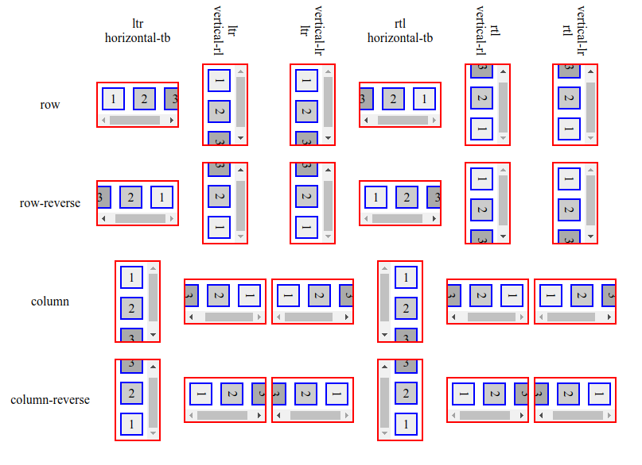
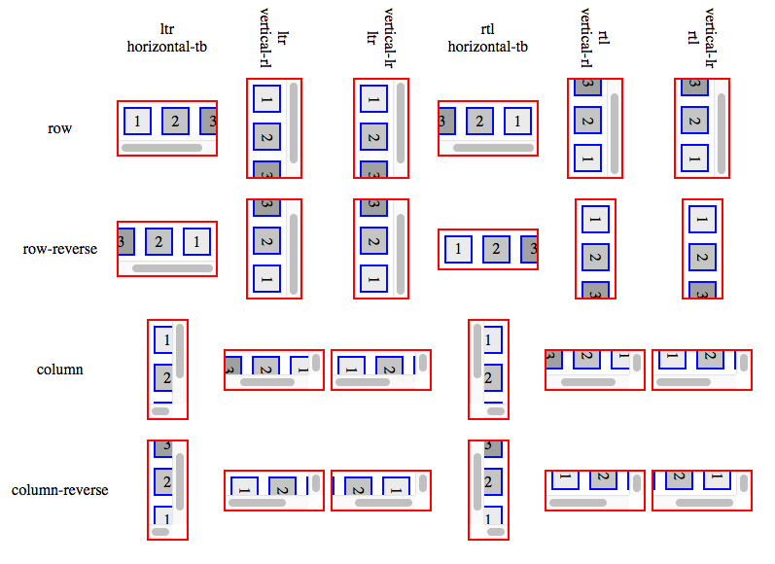
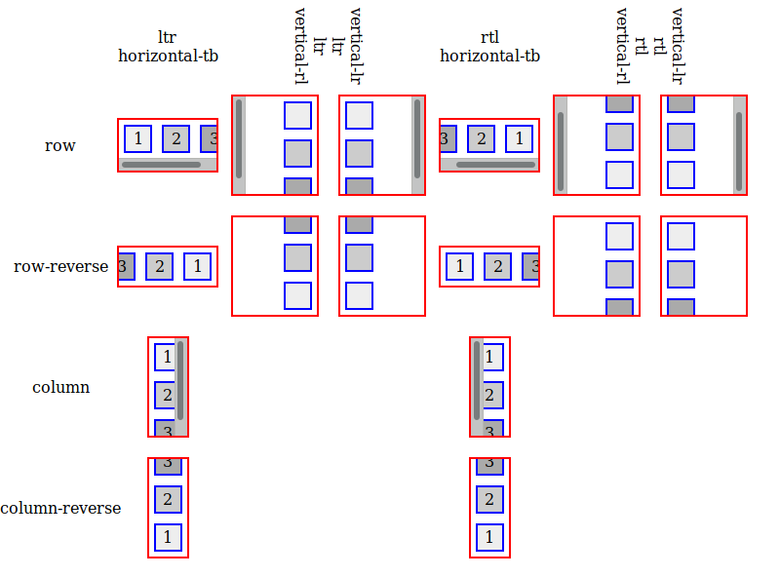
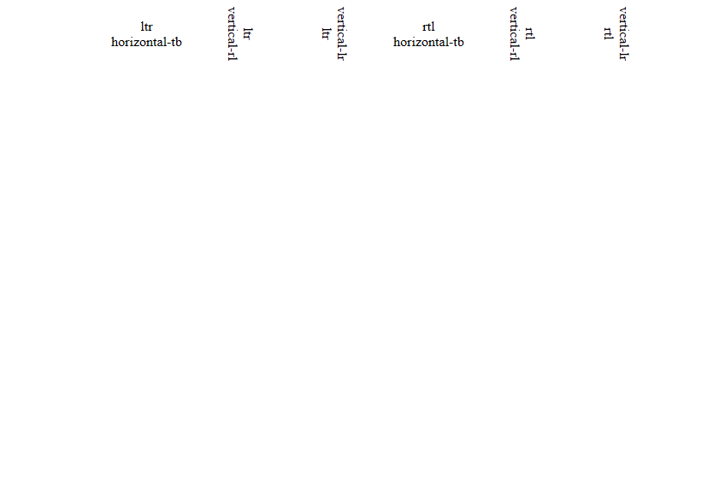

Slide 75
Layout: Existing Code
This is some of the oldest code in blink; much of it can be traced to KHTML.
Monolithic
Non-encapsulated
Not reentrant
Not thread-safe
Notes:
Code is some of the oldest.
“Crispy noodle code”.
Monolithic
non-encapsulated
non-reentrant
Although we actually *do* re-enter in some places. Don’t ask.
non-thread-safe

Slide 76
Layout: Monolithic
dirty

Slide 77
Layout: Non-encapsulated
?

Slide 78
Layout: Non-Reentrant

Slide 79
Layout NG and Custom Layout
CSS Custom Layout (aka Houdini) side-steps the combinatorial problem.
Layout NG is a ground-up re-architecture of Blink’s layout code.
Notes:
ikilpatrick@ is at BlinkOn, and will be happy to answer your Houdini questions.

Slide 80
Layout NG, in a Nutshell
“Constraint-driven” layout, i.e., encapsulation.
Immutable inputs (layout tree) and outputs (fragment tree).
Phase 1 (most of block flow layout) to ship in Q4/Q1.
Notes:
Layout NG potentially enables...
subtree layout
layout reuse
threaded layout
paint on the compositor thread
DOM async append

Slide 81
Layout NG Questions/Comments/Complaints
layout-dev@chromium.org

Slide 82
Rendering. So Hot Right Now.
Big things are happening!
Stay tuned.
Notes:
We were saddled with very crufty legacy code
With natural turnover, institutional memory was fading fast.
These are big, fundamental changes, and they are overdue.
These projects are complicated, difficult to land, low tolerance for error, long timelines
Much longer than the life of an average Google project.
After 40 years in the desert lies the promised land.

